Slide 1


MULTILEVEL MARKETING IN REAL ESTATE?
Sr HAJI NORDIN BIN DAHAROM
DIRECTOR GENERAL OF VALUATION AND PROPERTY SERVICES
VALUATION AND PROPERTY SERVICES DEPARTMENT (JPPH)
MINISTRY OF FINANCE MALAYSIA
Notes:
yyyyyyyyyy

Slide 2
INTRODUCTION
Organization marketing
  To develop satisfying relationships customers
  Benefit the organizations
  Benefit the society
Organizational level
  Marketing is vital business function
  For profit : task to bring revenue
  Not-for profit : attracting customers needed to support the mission (raising donation)
  Marketing is way to interact with public
Notes:
ttttttttt

Slide 3
MARKETING EVOLUTION
Marketing start in early 1900s
  Basic concept of economy
  Demand
  Supply
Before 1950s
  Strategy in selling more product and services with little regards for what customers wanted
  Sell as “much as we can”
  Little concern on relationship with customer
In 1950s
  Philosophy in understanding what customers need
  Know the customers
  Initiate process of developing and marketing product and services
  Encourage customer to purchase more

Slide 4
MARKETING EVOLUTION
Digital era or social marketing era
  Change in technology
  Initiate building personel connections
  Building relationships on a global scale
  Involving customers directly in product development decisions
  Utilizing the internet to spur word-of-mouth marketing
  Leverage loyal customer relationships
  Social media:
      Has power of crowd sourcing
      Continuous engagement with clients
      Provide easiest two way conversations
      With accessible data, complex model can be created
      May know customers behavior
      Provide custom tailored promotions
      Search engine optimization

Slide 5
THE NEED OF REAL ESTATE AGENTS
National survey in Norway: Mary, A.S (2015)
The respondents was asked on what sales method they chose when they sold their property.

Slide 6
OVERVIEW OF ESTATE AGENT PROFESSION
Registered with Board of Valuers, Appraisers, Estate Agent and Property Managers
Provide service in buying, selling and leasing property
Defined under section 22C of the Act, only Registered Estate Agents can practice
Currently : 2,000 estate registered with the BOARD
Perception as multi-millionaires profesion
In reality: difficult job, long working hours, odds working hours, uncertain income
Real estate agents contribute a lot to the economy as reported by the Department of statistics Malaysia

Slide 7
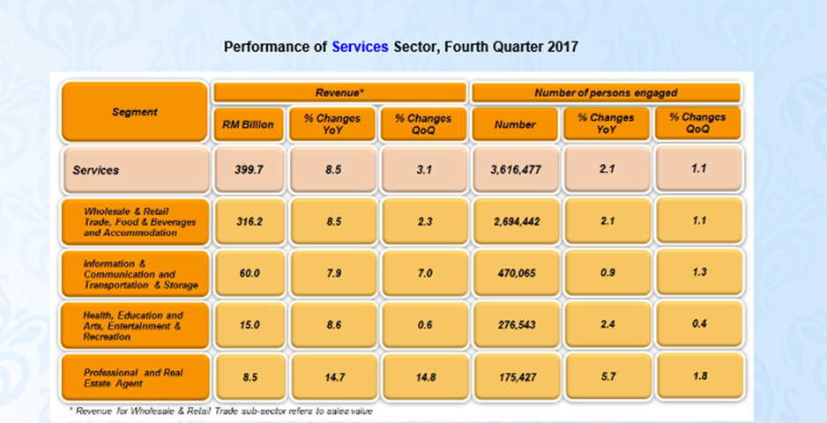
PERFORMANCE OF SERVICES SECTOR Q4 2017
Source : Department of Statistics, Malaysia

Slide 8
CRITERIA FOR SUCCESS ESTATE AGENTS

Slide 9
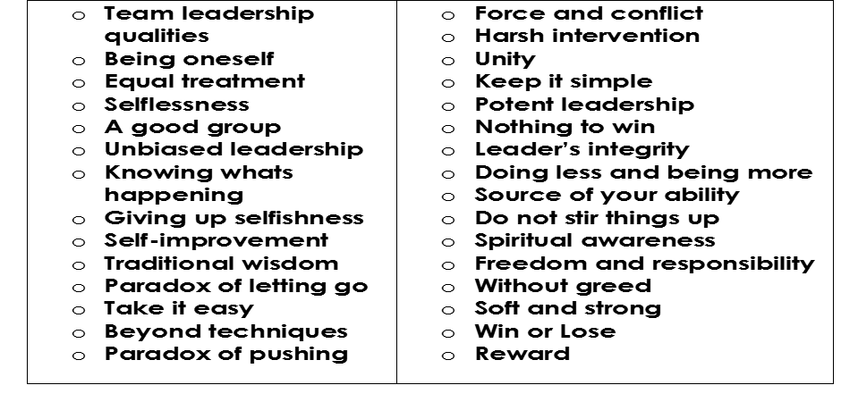
LEADERSHIP STYLE FOR REAL ESTATE AGENTS
Combination of western and eastern perspective
(As suggested by Low and Sirpal (1995))
  81 Qualities of Tao Te Ching concept and the most important qualities are:

Slide 10
AGENCY FIRM’S ASSESSMENT CRITERIA
Study by Low and Kee (1994) on the importance Criteria of Agency Firms
Attribute / Criteria | Percentage
Good track record | 100.0
Ability to achieve desired results | 100.0
Professionalism in dealings | 100.0
Ability to provide good service | 100.0
Dedication and total commitment | 97.6
Up to date with property trends | 97.6
Reputation | 97.6
Qualified and experienced team | 95.2
Knowledge of housing developers’ rules and other related acts | 92.9
Creativity in marketing | 90.5
Big client base | 90.5
Strong research backup | 83.3
Willingness to co-broke | 83.3
Ability to provide other real estate services | 81.0
Flexibility in fee arrangements | 71.4
International network | 69.0
Availability of meeting and display facilities at office | 52.4
Easily accessible office | 47.6
Ample parking facilities at office | 45.2
Location in a good-class building | 33.3
Proximity to developer’s office | 16.7

Slide 11
CONCEPT OF MULTILEVEL MARKETING
MOST POPULAR MLM COMPANY IN MALAYSIA
MLM
  Individuals associate with a parent company
  Compensated based on sales of product or service
  Commission is earned on sales
  Leader will recruit downline
AMWAY
TUPPERWARE (M) SDN BHD
D’HERBS

Slide 12
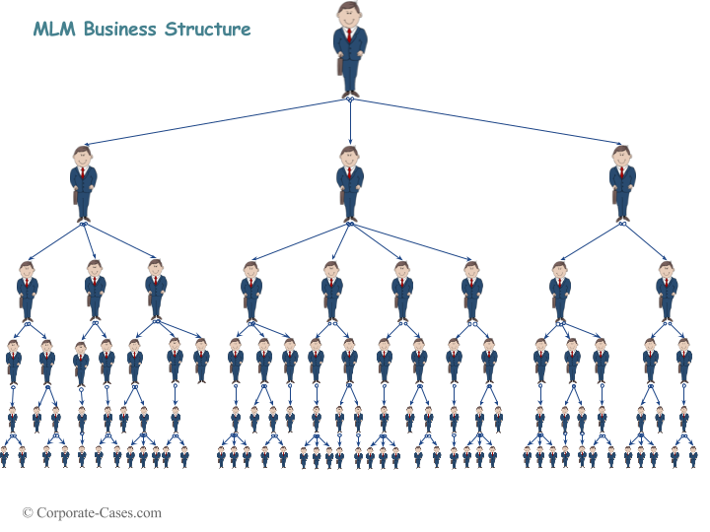

ESTATE AGENT STRUCTURE
ESTATE AGENT
MLM BUSINESS STRUCTURE
REN
REN
REN
REN
REN
REN
REN
REN
REN
REN
REN
REN
REN
REN
REN
REN
REN
REN
REN
REN
20 REAL ESTATE NEGOTIATOR
$$+$$
10 REN
(WITH APPROVAL FROM BOARD)

Slide 13
SUITABILITY OF MLM IN REAL ESTATE AGENCY
Concept of MLM in other type of business can be adopted in Estate Agency provided:
  The company has an effective marketing manager
  Responsible owner-manager for planning, organizing, directing and controlling the firm’s activities
MLM concept
  Up-line mentors to help the business
  Down-line to push for higher levels of success
Real Estate
  Down-line in the team will help to build the income
  They are the contracting team, realtors, property manager and investors
Multilevel Marketing must active via
  Facebook
  WhatsApp
  Telegrams
  Email
  Other new technology tools

Slide 14
KELLER WILLIAMS COMMISSION STRUCTURE
Keller Williams commission split is very competitive compared to other real estate firms.
Every agent is treated exactly the same
There are no prima donna’s running around yelling at new agents for doing someting wrong or parking in their coveted reserved parking space
Every agents is on 70:30 commission split
AGENT
BROKER
Notes:
Regardless to rules and regulation in Malaysia, lets us have a look at a marketing model for one of Real Estate Agent in other country.
The Model known as Keller Williams Realty Commission Structure

Slide 15
EXAMPLE OF KELLER WILLIAM COMMISSION SPLIT
Treating real estate agents like shareholders for the growth of the
company as practiced for some company in oversea.
Example of commission model are as follow:-
CAPPED : $20,000 – company dollar
$3,000 – royalty
Total : $23,000 – forgiveable + risk free
Split say 70/30 or 64/30/6
Agent Company Royalty
$200,000 closing sale as an example
$200,000 x 3% = $6,000
(Net : RM3,840, Company : $1,800, Royalty:$360)

Slide 16
WHAT IS CAP
Cap is determined:
by the average median home price in certain area
usually amounts to selling 8-10 houses per year.
Once an agent reaches a set of production (cap), they are no longer required to pay the office a split
meaning the agent is at 100% commission split until their fiscal year starts again

Slide 17
Split vs Cost of Sale
Example 1:
Cost of sale is $3,000,000
$3,000,000 x 3% = $90,000 (Gross Close Commission
Income/GCI)
$20,000 CAP
GCI of $90,000
= 22%
Therefore, the split should be 78:22
Example 2:
Cost of sale is $6,000,000
$6,000,000 x 3% = $180,000 (GCI)
$20,000 CAP
GCI of $180,000
= 11%
Therefore, the split should be 89/11
AGENT
COMPANY
AGENT
COMPANY
Notes:
Based on above, it can be concluded that the model can be applied in Malaysia context which it more on the profit sharing.
Real estate agent become as shareholders in the company to share the profit.

Slide 18
CONCLUSION
Untill now there is no Act or Legislation in Malaysia permit operation of Estate Agent to be as a MLM BUT
The concept of MLM can be adopted in real estate for enhancement of the profession and for making more millionnaires in Malaysia
Benefit the young generation
Benefit the industry
THANK YOU

